Slide 1

How to create video lessons using
Loom?

Slide 2
Table of Contents

Slide 3
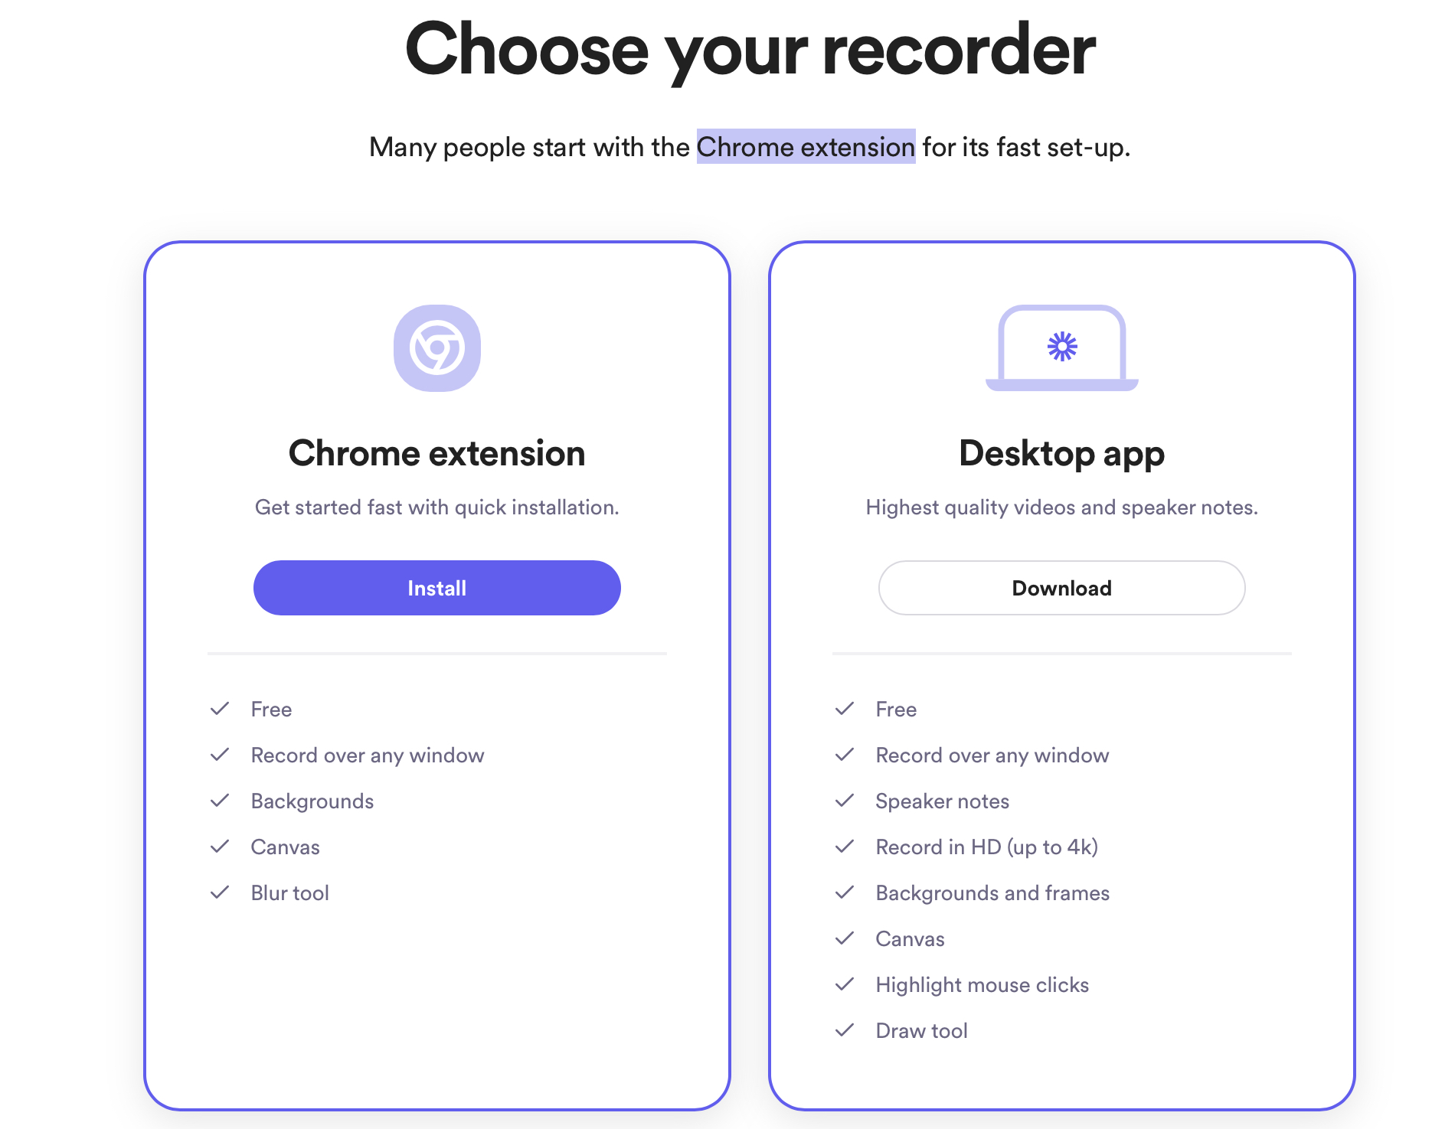
Step-1: Download Loom (Desktop version)
Visit – www.loom.com
Download Desktop version

Slide 4
Step 2: Setting up Camera and Microphone
Bullet points
Point 2

Slide 5
Thanks for your time and attention!
ilearnx.live

